Slide 1

Rise of Civilizations
Image src: http://vignette4.wikia.nocookie.net/steamtradingcards/images/5/5a/Age_of_Empires_II_HD_Edition_Background__A_Deadly_Game.jpg/revision/latest?cb=20140509061420
Group 13 Development Project
Akhil Kateja, Adil Qaisar, Andriy Serafyn,
Himanshu Anand

Slide 2
Game Overview
The Rise of Civilizations is a turn based strategy game wherein the player has an option to play either against an AI or against other players on his/her local area network.
The game requires players to build a base where they build their units and eventually defeat all the other players that are not in their team.
This presentation will cover the functional requirements, non-functional requirements and test cases for the game.

Slide 3
Functional Requirements Game Login and Configuration
When logging in, the system must allow the player to play in Single player (Play against Game AI) or Multi Player modes and this will allow the player to start a new game. In addition, the system must allow the player to resume a previously saved game.
The system must also allow the player to change gameplay settings by selecting the Options menu such as setting the keyboard keys, game volume or the mouse sensitivity.

Slide 4
Functional Requirements Game Login and Configuration
The system must allow the player to gain knowledge about a particular era or civilization by selecting the History option.
The system must allow the player to gain information about different aspects of the game such as "Marching and Fighting", "Feeding the Army", "Training the troops" and “Fighting Battles” by selecting the Learn to Play option.

Slide 5
Functional Requirements Game Login and Configuration
The system must allow the player to customize the game with options such as population, difficulty level (Easy, Moderate and Hard), map style, starting age, civilization (Britons, Mongols, Goths and Persians), resources (Gold, Food and Stone), record game, building materials and player skill level.
Finally, the system must allow the player to pause the game at any moment and to resume immediately thereafter.

Slide 6
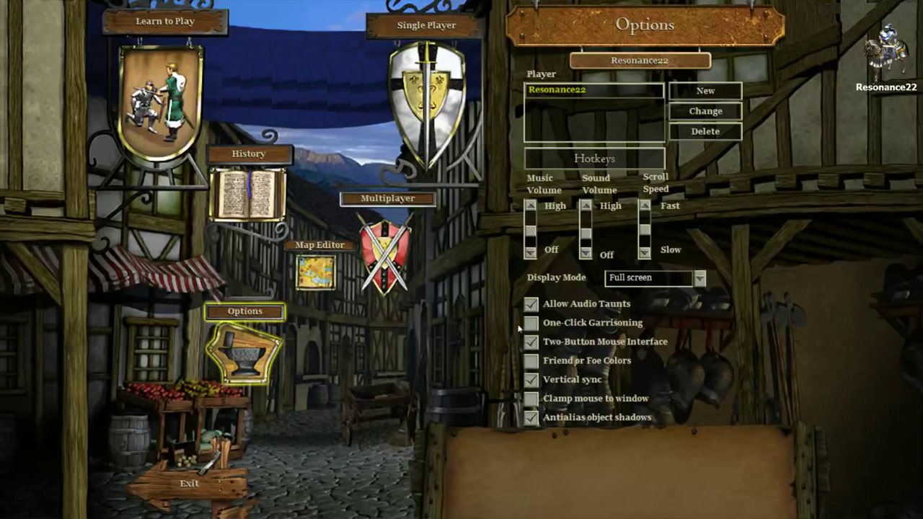
Image source: https://www.youtube.com/watch?v=mMey4_d-itA&list=PLEQWWx1EYwpqmXRFnWeBLh77n4tzujrs2&index=1

Slide 7
Functional Requirements Game Start
The system must allow the player to begin the game after setting all the parameters.
Once the game is started, the system must display a map for the player, along with the player’s current score, timer and the name and number of all resources available. The system must display all the villagers and scout cavalry available with the player at that time.

Slide 8
Functional Requirements Game Start
The system must display the health of the villagers and the weapons owned by the scout cavalry, by clicking on any of them. The system must allow the player to guide their movements.
The system must also display the player with a town center which acts as center for storing food and researching technologies.
The system must allow the player to discover unexplored areas by moving the scout cavalry to different places on the map.

Slide 9
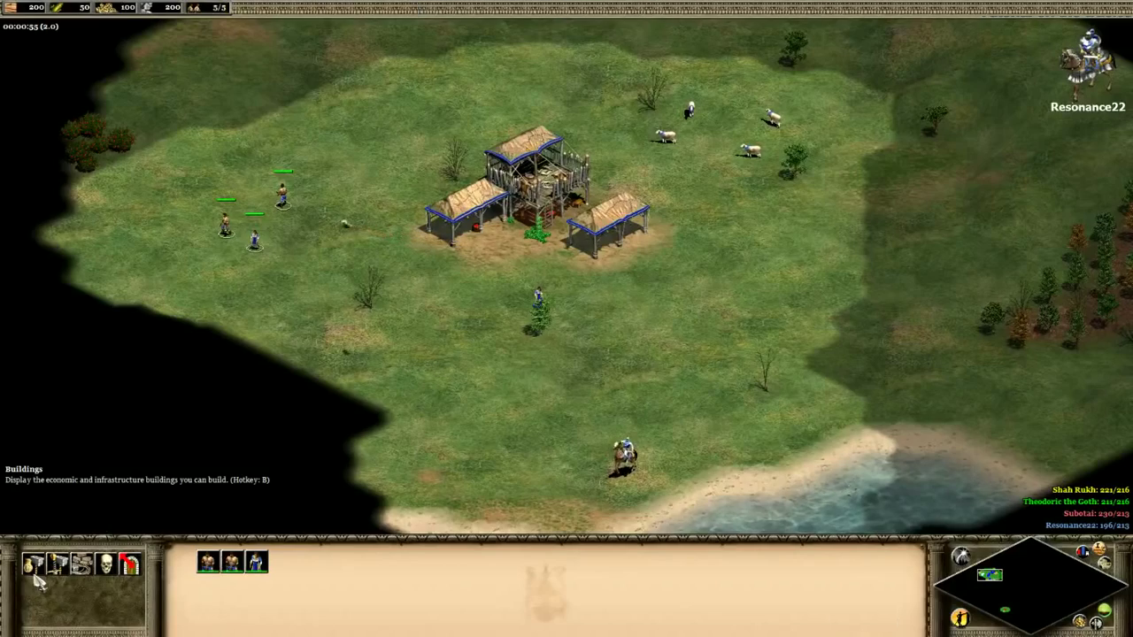
Image source: https://www.youtube.com/watch?v=mMey4_d-itA&list=PLEQWWx1EYwpqmXRFnWeBLh77n4tzujrs2&index=1

Slide 10
Functional Requirements Players Build Units
They system must allow the player to be able to select villagers to build houses, buildings, lumber centers, farms, docks, gold, mills and stone mining units with resources available to them.
The system must allow the player to select villagers to build mills and farms as renewable sources of food or to gain health and stack food from farming or hunting in the town center.

Slide 11
Functional Requirements Players Build Units
The system must allow the player to build army units such as barracks, archery ranges, castles and associate armed men or archers with them.
The system must increase the civilization’s resources such as wood, gold, stone, food etc. based on the number of units built.

Slide 12
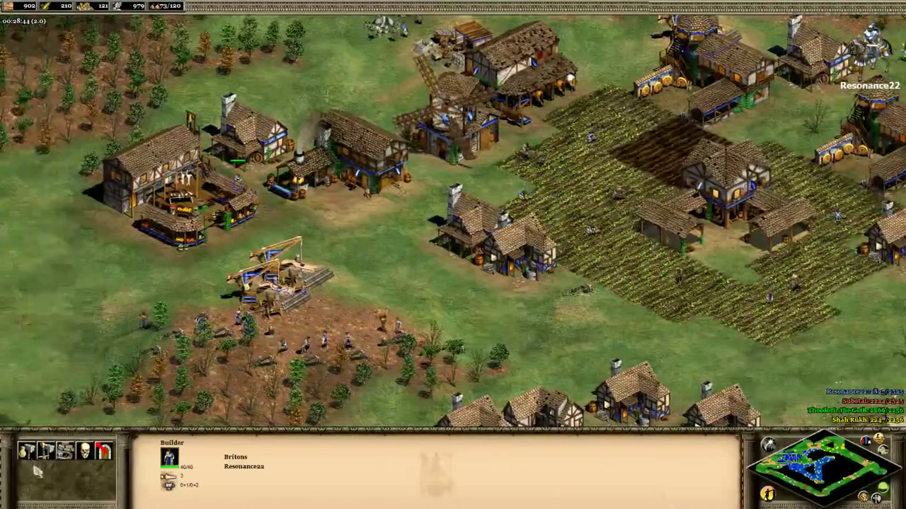
Image source: https://www.youtube.com/watch?v=mMey4_d-itA&list=PLEQWWx1EYwpqmXRFnWeBLh77n4tzujrs2&index=1

Slide 13
Functional Requirements Players Engage in Conquest
The system must allow the player to engage in conquests with other players and deploy their army units in a defensive or rigorous attacking response.
The system must allow the player to use the available technologies, such as being able to see the units or type of army units (archery units) available with other player(s) in a conquest.

Slide 14
Functional Requirements Players Engage in Conquest
The system must allow the player to add new villagers in case they lose some in an attack.
The system must allow the player to build castles which will have unique units of civilization which no other unit will have access to.

Slide 15
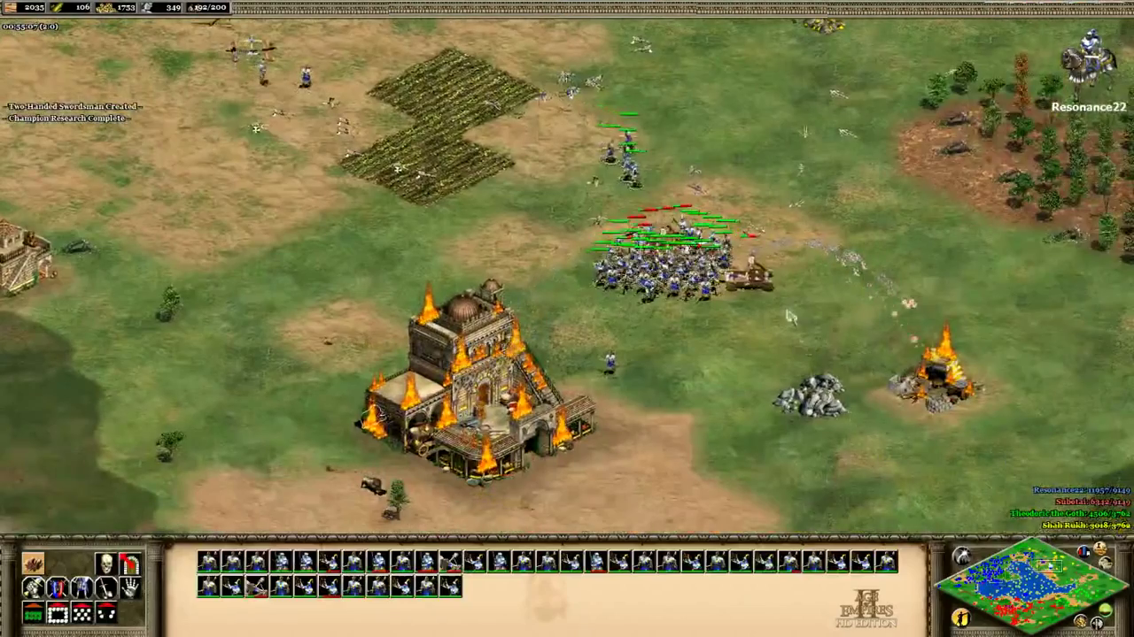
Image source: https://www.youtube.com/watch?v=mMey4_d-itA&list=PLEQWWx1EYwpqmXRFnWeBLh77n4tzujrs2&index=1

Slide 16
Functional Requirements Players Engage in Trade
The system must allow player to be able to trade with other users throughout the game. The system must allow the player to use the chat feature to help facilitate the trade of goods.
The system must implement a scorecard for each trade to help evaluate the deal for each player.

Slide 17
Functional Requirements End Game
The system must advance the game to the next age when the player builds enough units and has enough resources to move to the next level.
The system must end the game when the player has played in all the eras and has captured all the available resources, such that there are no more opponents left in the game to play against.

Slide 18
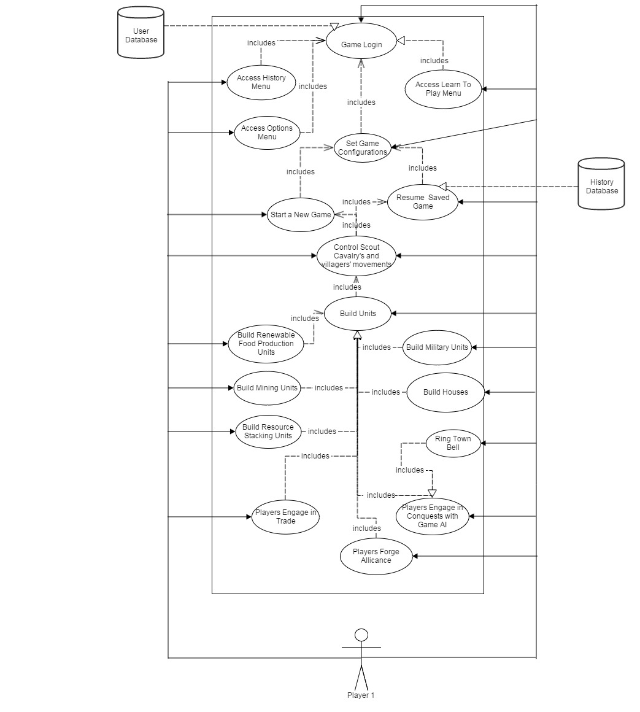
Use Case Diagram

Slide 19
Non-Functional Requirements Usability
The game shall be easy to use as in it will be easy for a child of 10 years and anyone above that.
There shall be an option for recovering forgotten passwords.
The game shall be only in English.
The game shall allow the user to personalize their username, and profile space.
This game shall be usable by anyone who possesses very basic computer skills.

Slide 20
Non-Functional Requirements Reliability
There should be no loss of user data in the event of a system failure.
In the event of a failure, the game should take no longer than 15 seconds to re-load the most recent game environment.
There should be weekly maintenance to the game’s system.

Slide 21
Non-Functional Requirements Speed and Latency
The game must execute and run at least 120 fps (frames per second).
The system in which the game is run on must have at least a 1.4 GHz (gigahertz) processor.
The game should not have a load screen longer than 5 seconds between levels of gameplay.
Finally, the time to reach the main menu upon the game launch shall not exceed 15 seconds.

Slide 22
Non-Functional Requirements Supportability
The product shall be able to provide assistance for all users 24/7 through an email automated system.
Users shall receive help when asked within 24 hours of request.

Slide 23
Test Conditions : Game Login and Configuration
Test Name | Description
Select_SinglePlayer | The user should be able to choose to play against the computer.
Select_MultiPlayer | The user should be able to choose to play against players on LAN.
Set_GamePlaySettings | The user should be able to fill out the player name and customize the gameplay settings such as setting the keyboard keys, setting the game volume level or to alter the mouse sensitivity by selecting the "Options" menu.
Select_LearnToPlay | The user should be able to select the Learn to play option.
Select_History | The user should be able to select the History option to learn about a particular era or civilization.
Set_GameParameters_SinglePlayer | The user should be able to set the game parameters such as population size,difficulty level,map style,civilization,location

Slide 24
Test Conditions : Game Start and Build Units
Test Name | Description
Start_Game | The user should be able to start a new game.
Guide_movement | The user should be able to guide the movement of villagers,scout cavalry and sheep.
Build_Units | The user should be able to build lumber centre, houses, farms, mills, docks, castles, archery units, stone and gold mining units.

Slide 25
Test Conditions : Players Engage in Conquests
Test Name | Descripttion
Issue_Alert | The system should issue an alert if an adversary enters the village/town
Attack_Adversary | The user should be able to attack the adversary
Add_resources/units | The user should be able to add new resources and units at any time
Press_RingTownBell | The user should be able to press “Ring the Town Bell” option to signal the villagers to seek shelter during battle
Win_Conquest | The user should be able to see the acquired resources from the adversary after winning the conquest

Slide 26
Test Conditions : Others
Test Name | Description
Select_NextCivilization | The user should be able to advance to the next civilization by selecting the next round provided they have sufficient resources
Display_Leaderboard | The user should be able to view the Leaderboard
Trade_resources | The user should be able to trade goods with other players
Resume_savedGame | The user should be able to resume a previously saved game
Pause_Game | The user should be able to pause an already started game
Auto_Save_SinglePlayer | The user should be able to see an auto saved game after they have closed the game
Browse_Map | The user should be able to browse through the map

Slide 27
Test Plan Summary
Test Level | Start Time | Duration | External Party | Project Team | Business
Unit Testing | 3 weeks before each release. | 1 week. |  | Primary
Integration Testing | 2 weeks before each release. | 1 week. |  | Primary
User Acceptance Testing | 1 week before each release. | 1 week. |  | Secondary | Primary
Security Testing | 1 week before Global Availability (GA). | 1 week. | Primary | Secondary
Product Verification Testing | 1 week before each product release. | 1 week. |  | Secondary | Primary

